Slide 1


SMART INDIA HACKATHON 2024
TITLE PAGE
Problem Statement ID –
Problem Statement Title-
Theme-
PS Category- Software/Hardware
Team ID-
Team Name (Registered on portal)

Slide 2

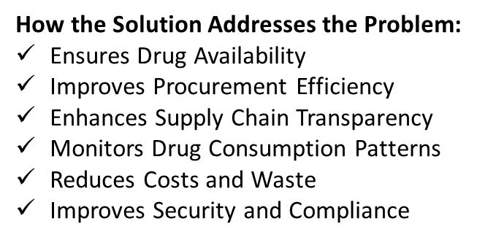
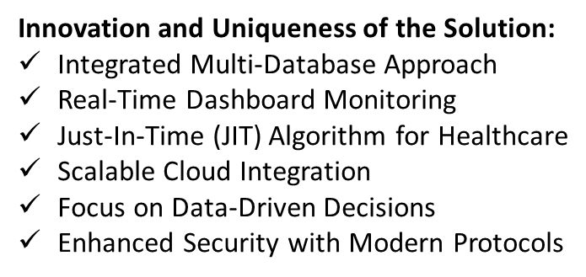
IDEA TITLE
Proposed Solution
The proposed solution is a Drug Inventory and Supply Chain Tracking System designed to streamline the distribution and availability of drugs in hospitals and medical institutions. The system will use modern technologies to provide real-time tracking, monitoring, and management of drug inventory across the supply chain. The system aims to ensure that the right drugs are available in the right quantity, at the right time, place, and cost, in the right condition, and for the right people. Below is a detailed breakdown of the proposed solution, its components, how it addresses the identified problems, and its innovative aspects.

Slide 3

TECHNICAL APPROACH
Technologies to be used (e.g. programming languages, frameworks, hardware)
Methodology and process for implementation (Flow Charts/Images/ working prototype)

Slide 4
FEASIBILITY AND VIABILITY
Analysis of the feasibility of the idea
Potential challenges and risks
Strategies for overcoming these challenges

Slide 5
IMPACT AND BENEFITS
Potential impact on the target audience
Benefits of the solution (social, economic, environmental, etc.)

Slide 6
RESEARCH AND REFERENCES
Details / Links of the reference and research work

Slide 7
IMPORTANT INSTRUCTIONS
Please ensure below pointers are met while submitting the Idea PPT:
Kindly keep the maximum slides limit up to six (6). ( Including the title slide)
Try to avoid paragraphs and post your idea in points /diagrams / Infographics /pictures
Keep your explanation precise and easy to understand
Idea should be unique and novel.
You can only use provided template for making the PPT without changing the idea details pointers (mentioned in previous slides).
You need to save the file in PDF and upload the same on portal. No PPT, Word Doc or any other format will be supported.
Note - You can delete this slide (Important Pointers) when you upload the details of your idea on SIH portal.

